Slide 1


BT3008
JAVA PROGRAMMIING…
SHYAMANTAK DUBEY
23SCSE1420091
KRISH KUMAR
23SCSE1420086
ARYAN TYAGI
23SCSE1420017
AMAN KASHYAP
23SCSE1420067

Slide 2

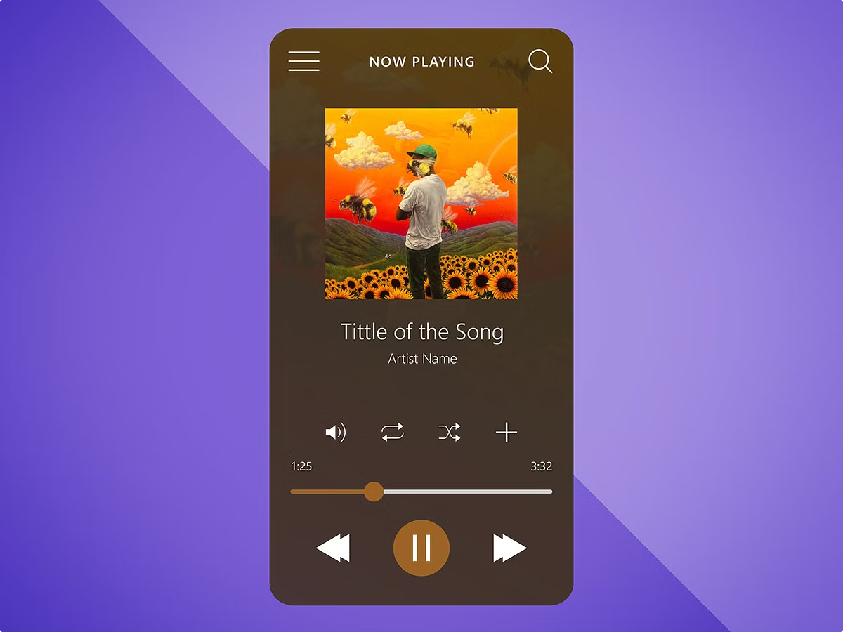
Music Player System
This basic music player system built with Java allows users to easily play, pause, skip, and manage their music library. It provides a simple and intuitive interface for music enthusiasts of all skill levels.

Slide 3

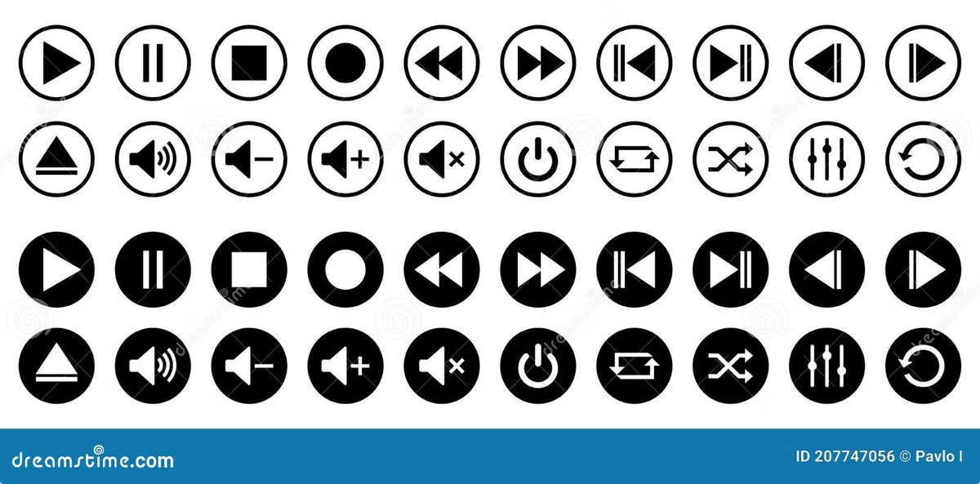
Problem Statement
Accessibility
Functionality
Develop a music player that is easy to use and navigate, even for beginners with limited technical expertise.
Implement core features like play, pause, skip, and library management to provide a seamless music listening experience.
Scalability
Design the system to handle growing music libraries and potential future enhancements without significant changes.

Slide 4

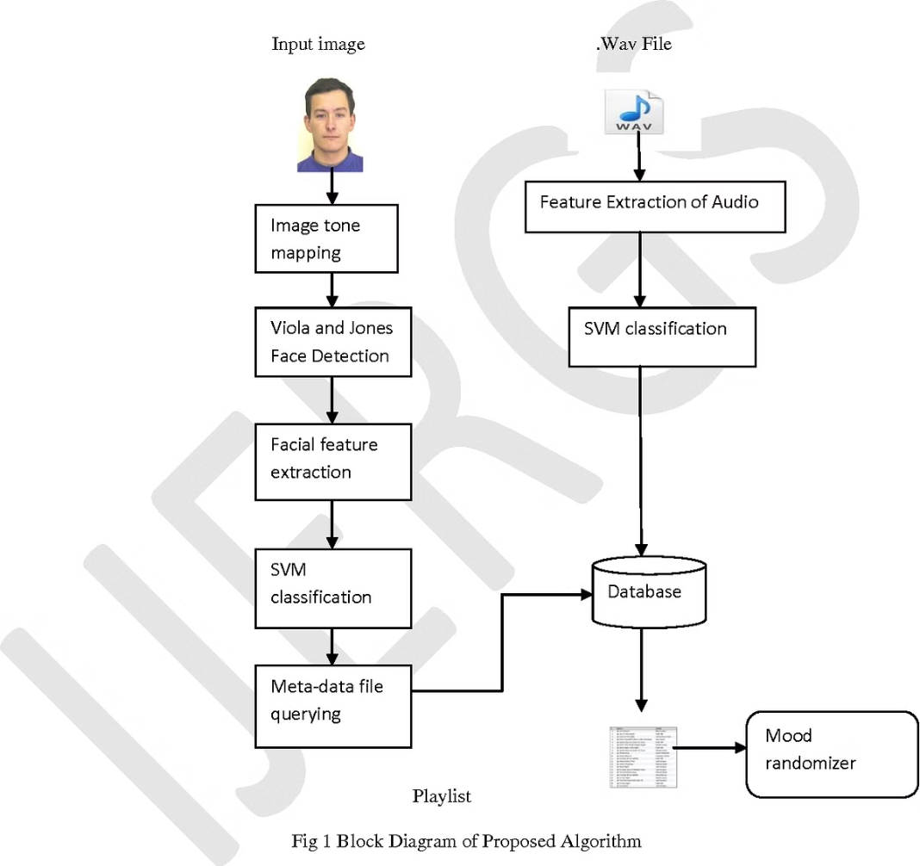
Flow Diagram
1
CREATE PLAYLISTS
2
Play/Pause
Users can play or pause the currently selected song using the player controls.
3
EDIT
Users can edit the next or previous song, or seek forward and backward within the current song.

Slide 5
Technical Stacks
Java
Audio APIs
File I/O
The core programming language used to build the music player system.
Utilized Java audio APIs to handle audio playback, decoding, and control.
Implemented file input/output operations to load and manage the user's music library.

Slide 6


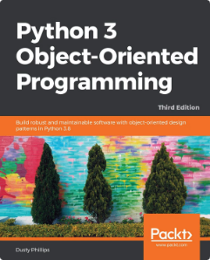



References
Java Documentation
Java Audio APIs
Java File I/O
Official Java language and API documentation.
Tutorials and examples on using Java audio libraries.
Guides on Java file input/output operations.

